Slide 1
A Grid-wide, High-fidelity Electrical Substation Honeynet
Daisuke Mashima, Prageeth Gunathilaka, Binbin Chen, and Edwin Tjiong
Advanced Digital Sciences Center
Singapore
Acknowledgment:
This research is partly supported by the National Research Foundation, Prime Minister's Office, Singapore under the Energy Programme and administrated by the Energy Market Authority (EP Award No. NRF2014EWT-EIRP002-040) and in part by the research grant for the Human-Centered Cyber-physical Systems Programme at the Advanced Digital Sciences Center from Singapore’s Agency for Science, Technology and Research (A*STAR).

Slide 2
Background
For collecting and analyzing real-world attack vectors, honeypot is an effective tool used in general IT systems
ICS/Smart Grid Honeypot system is still in an early stage
A few ICS honeypot implementations, such as CONPOT etc. are available, but none of them support the emulation of physical system in high-fidelity manner.
Maybe OK for just collecting scanning activity, but not sufficient to retain attackers inside for slowing down attacks and/or performing longitudinal analysis

Slide 3
Outline
Attacker models in Smart Grid communication
Design of scalable, high-fidelity, standard-compliant smart grid honeynet
Proof-of-concept implementation using open-source tools
Preliminary evaluation of realism and scalability

Slide 4
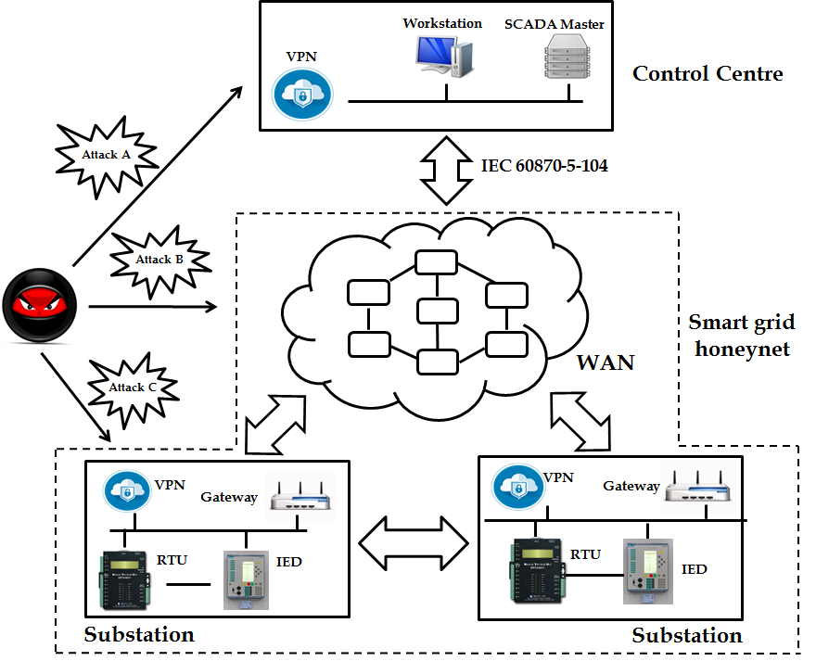
Attacker Models in Scope
A: Attack from control center
Compromised SCADA Master system
Man-in-the-middle attack by other workstations
B: Attack from network
Attack on public network infrastructure (i.e., Internet)
Attacks on wireless network (e.g., cellular)
C: Attacks via VPN interface
Intrusion into substation network
Injection of malicious commands

Slide 5
Desired Properties
Comprehensive, consistent power grid view
Attacker may have complete visibility on smart grid communication.
He may also have knowledge of power system laws and attempt probing.
Realistic network configuration
IP address, MAC address, communication protocols, LAN topology etc. should look realistic
Scalability for grid-wide emulation
Emulation of network with hundreds or thousands of substations should be possible with decent cost
Fingerprinting resistance
Fingerprinting tools (e.g., nmap) should not be able to find hint of honeypot
Use of virtualization technologies should not be identifiable (e.g., sufficient resource isolation among virtual instances)

Slide 6
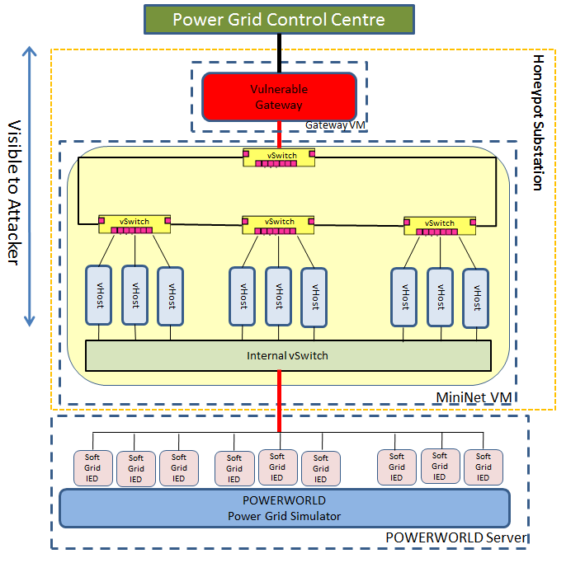
System Overview
Interconnected Substation Honeypots
Each substation honeypot consists of
Substation gateway VM
Assumed to be fully accessible to attackers
Connected to other substation honeypots
Open IEC 60870-5-104 (using OpenMUC library)
Mininet VM (Substation LAN)
Run multiple virtual IEDs, which speak IEC 61850 MMS protocol
Assume attackers cannot have shell access on virtual IEDs.
Can emulate any topology and bandwidth
Monitoring functionality can be implemented on the host OS (i.e., beneath VMs)
Not visible to attackers
Cyber-connected power grid simulation
Provided by SoftGrid* and PowerWorld
Emulate steady and transient state
Can support large-scale grid model, such as 2000 bus systems (with 7,000 IEDs)
Monitoring
(e.g., Wireshark)
*Gunathilaka, Prageeth, Daisuke Mashima, and Binbin Chen. "SoftGrid: A Software-based Smart Grid Testbed for Evaluating Substation Cybersecurity Solutions." Proceedings of the 2nd ACM Workshop on Cyber-Physical Systems Security and Privacy. ACM, 2016.

Slide 7
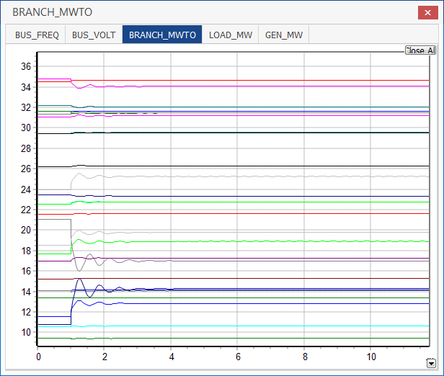
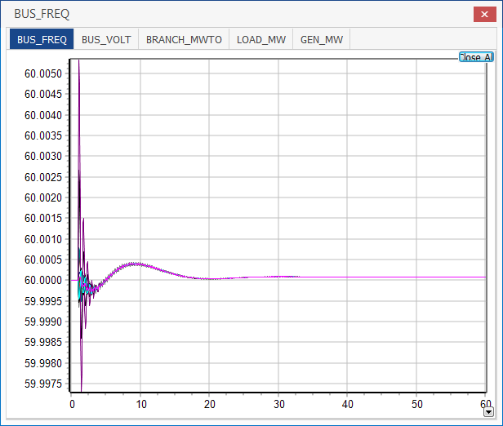
Evaluation (1)
Comprehensive, consistent power grid view
All honeypot substations are connected to single power flow simulator, and therefore share the consistent view.
When control is performed, the outcome from power flow simulator is made visible within a short latency.
Voltage and power flow are quick to reach new state so approximated with steady-state simulation
Frequency swing takes time so transient-state simulation is used (completed within 1 seconds when 30-sec transient-state simulation is used.)

Slide 8
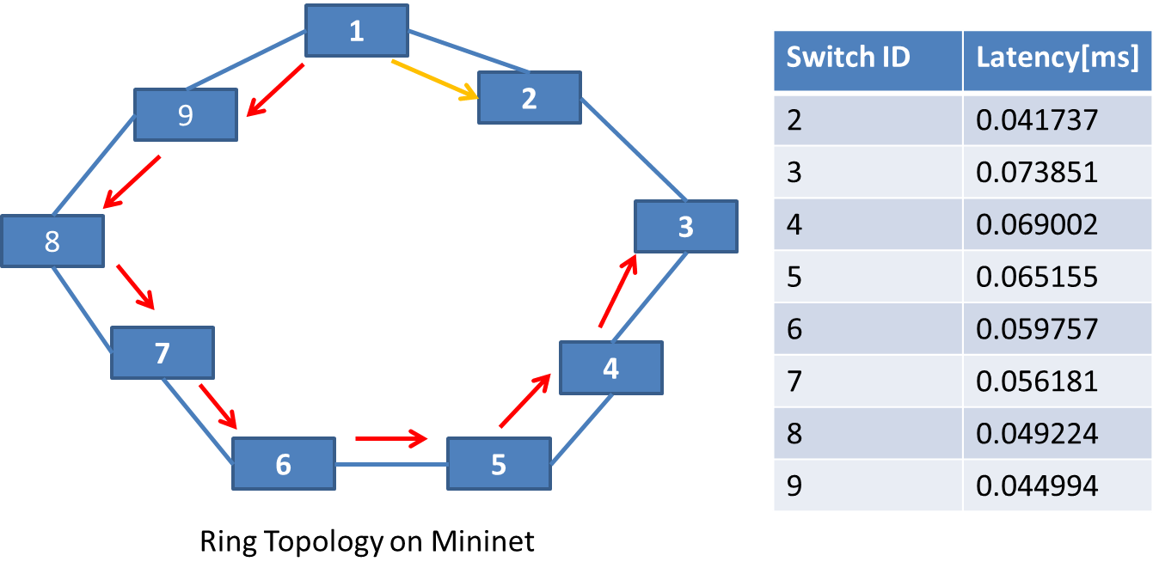
Evaluation (2)
Realistic network configuration
MAC address of honeypot gateway and virtual IEDs are configurable.
Support widely-used standard protocols, namely IEC 60870-5-104 and IEC 61850
Bandwidth, packet loss ratio etc., are also configurable.
Can safely support 200 virtual IEDs per substation
Latency on a ring topology looks realistic.
Substation GW

Slide 9
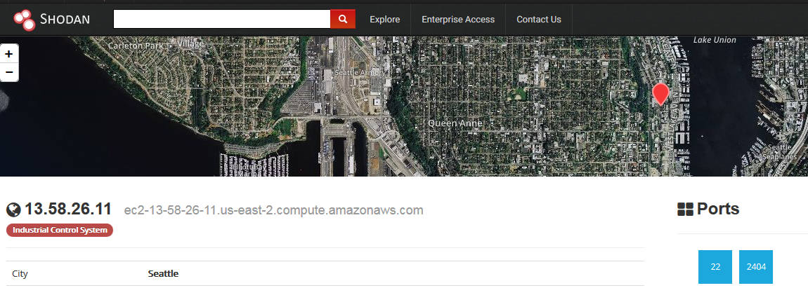
Evaluation (3)
Fingerprinting resistance
Scanning and OS fingerprinting by Nmap
Substation VM is identified as Linux (2.6.32) device that opens port 2404 and 22
Same as a commercial protocol translator (ZNX 202)
Virtual IEDs are identifies as a device with unknown OS that opens port 102
Shodan (https://www.shodan.io)
After 2weeks operation, indexed as a industrial control system but not flagged as a honeypot

Slide 10
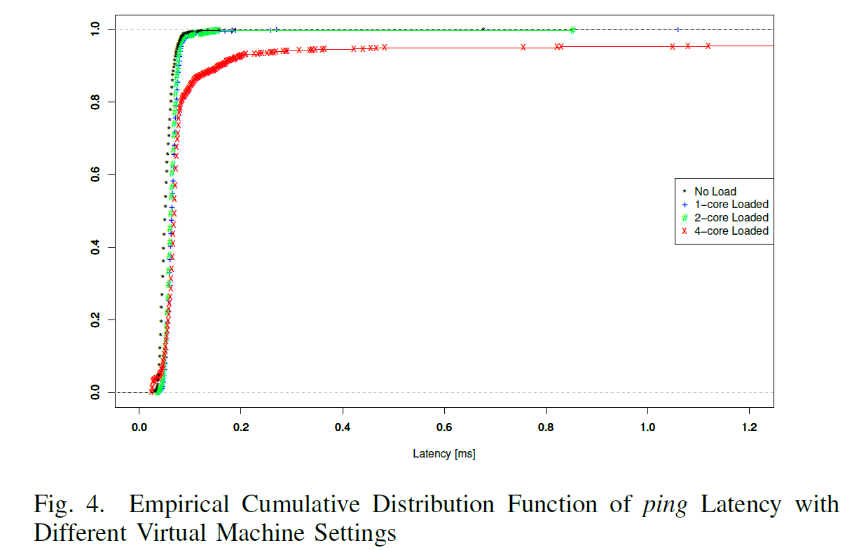
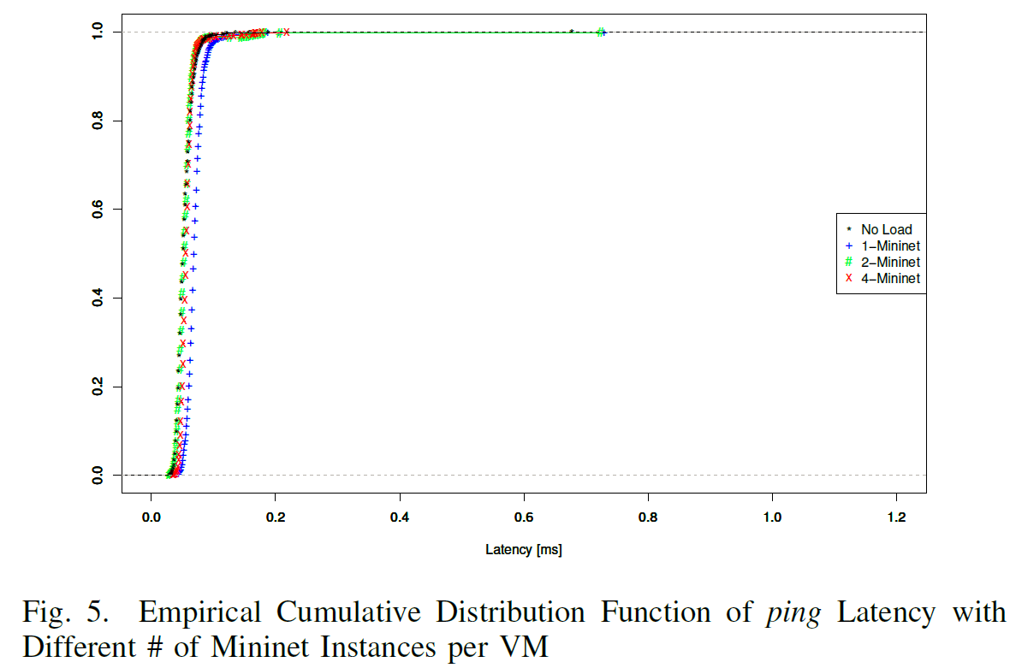
Evaluation (4)
Isolation among Virtual Instances
When a dedicated CPU core is allocated to each Mininet VM (substation LAN), sufficient isolation in terms of performance of emulated network is provided.
Also found that up to 4 substation LANs can be safely run on a single Mininet VM

Slide 11
Evaluation (5)
Scalability / Operational Cost
Theoretically, we can host up to 16 honeypot substations (GW and LAN) on a quad-core PC
The number is close to high-volt. substations in Singapore.
On National Cybersecurity Lab testbed (https://ncl.sg), we tested operation of 18 substations per node
Given CPU usage on the node is less than 30%, we can host more than 36 substations safely.
Operational cost to run a 200 and 1,500 substation system are US$390/month and US$2,700/month respectively.
Deployable also on Amazon EC2 (with minor modification).

Slide 12
Conclusions
We designed and implemented, scalable smart grid honeynet with high-fidelity power system simulation
Looking for industry and academic partners for extensively evaluating and enhancing the system.
Future enhancement includes:
Collection and analysis of real-world attacks
Incorporation of mechanical/actuation latency models
Realism evaluation through comparison of hardware-based power grid testbed
Generation of dummy, but realistic, SCADA/substation LAN traffic
Release honeypot codes as add-on for open-source SoftGrid project (URL: http://www.illinois.adsc.com.sg/softgrid/)

Slide 13
Thank you very much!
Questions?
For any interest, suggestion, or request, please feel free to contact us at:
Email: softgrid@adsc.com.sg

Slide 15
Smart Grid Honeypot/net Use Cases (1)
To counter Attack A:
In the control center, we can set up dummy SCADA Master and/or workstation that are intentionally made vulnerable
E.g., they may look like a back-up system
Outgoing traffic from those machines are routed to Smart Grid honeynet
Can be done by means of router configuration or software-defined network technologies
Control Center
SCADA
Master
Dummy
SCADA
Master
Dummy
Workstation
Real
system
Smart Grid Honeynet

Slide 16
Smart Grid Honeypot/net Use Cases (2)
To counter Attack B:
Some of honeypot substations can be connected to the Internet (or other type of public WAN)
Some of honeypot substations can be equipped with cellular communication module
To counter Attack C:
Expose VPN interface of substation gateway, configure with weak credential, to public
Smart Grid Honeynet
WAN /
Internet
Substation Honeypot
Substation Honeypot
Substation Honeypot
Substation Honeypot
Substation Honeypot
Substation Honeypot
Substation Honeypot

